Slide 1
Object Oriented Thoughts
A paradigm shift from procedural to object-based programming

Slide 2
Why do we need the object-based thinking?
For modeling real-world problems
For better code organization and reuse
For easier maintenance and scalability

Slide 3
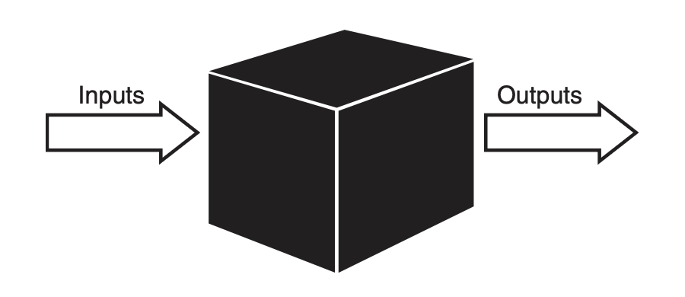
Procedural Versus OO Programming

Slide 4
Object forms with attributes and behaviors
An object is an entity that contains both data and behavior.
Behaviors are contained in methods
Attributes are contained in variables
A person has attributes, such as eye color, age, height, and so on.
A person also has behaviors, such as walking, talking, breathing, and so on.
In OO design, the attributes and behaviors are contained within a single object, whereas in procedural, or structured design, the attributes and behaviors are normally separated.

Slide 5
Let’s discuss some examples of Objects

Slide 6
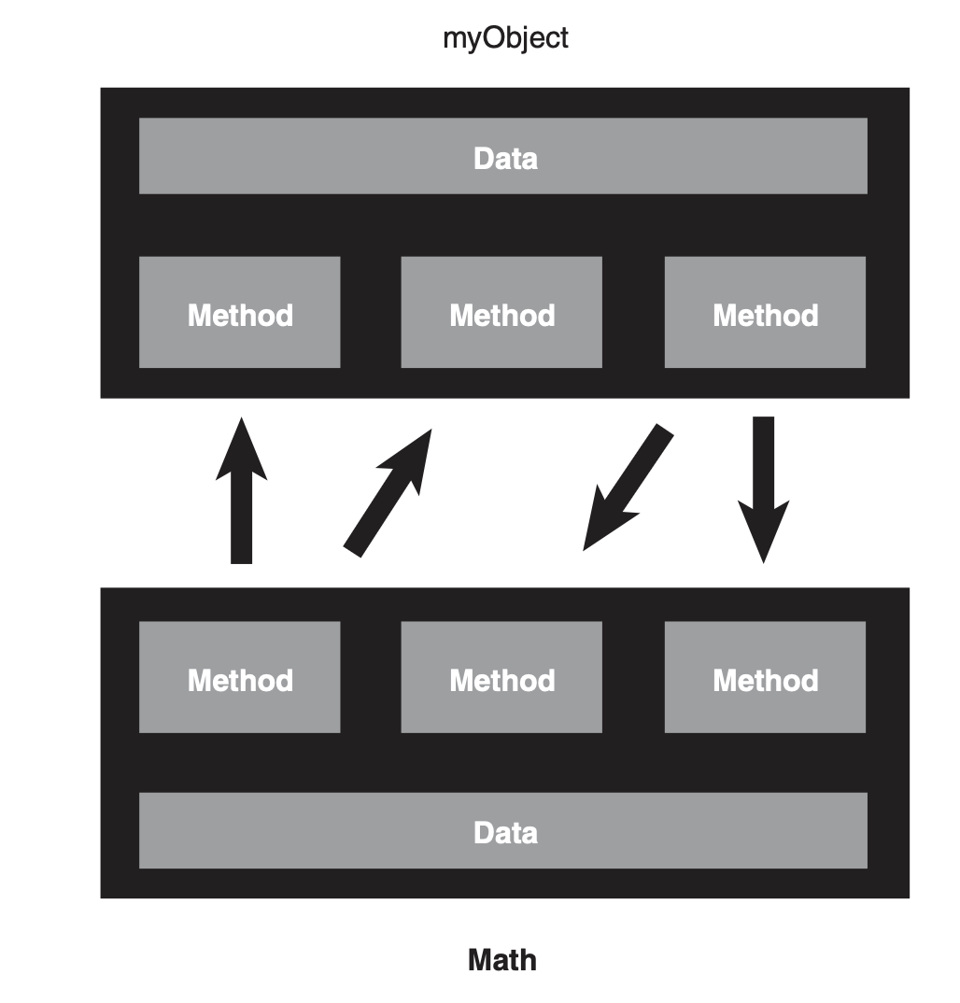
Class Design Guidelines
Data Hiding
Communication

Slide 7
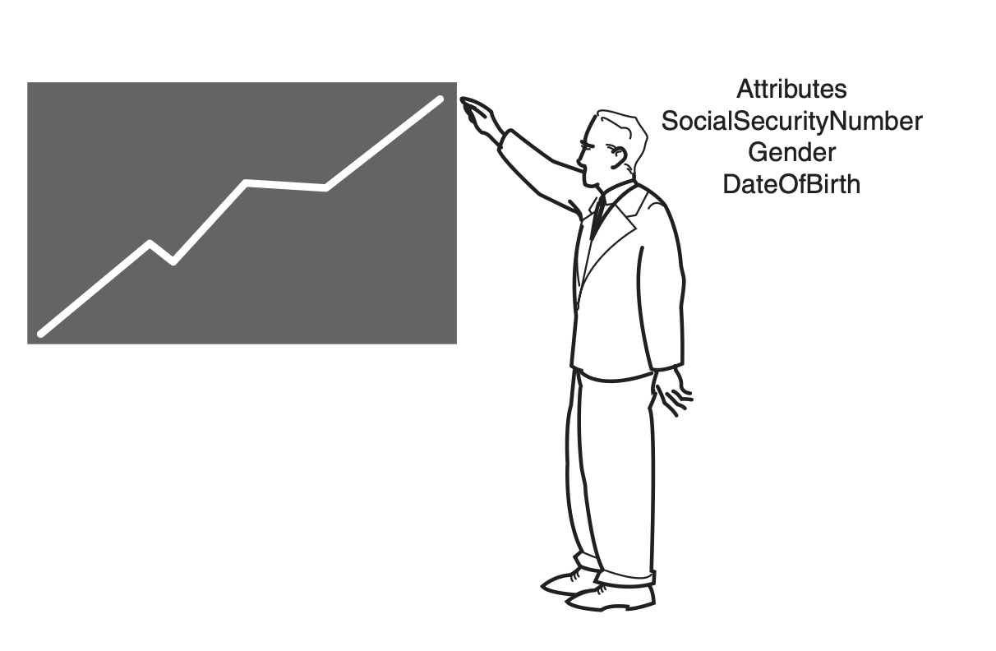
How to communicate with Objects?

Slide 8
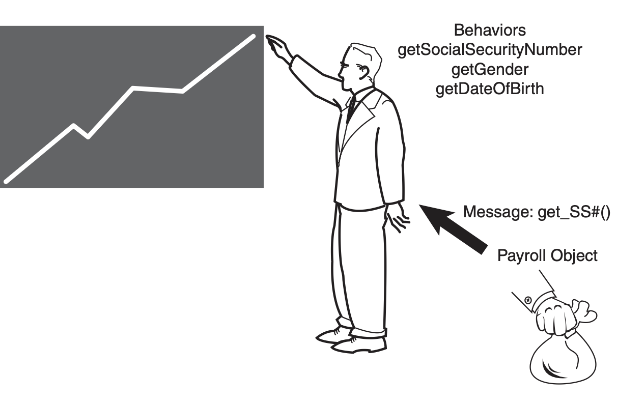
How to communicate with Objects?

Slide 9
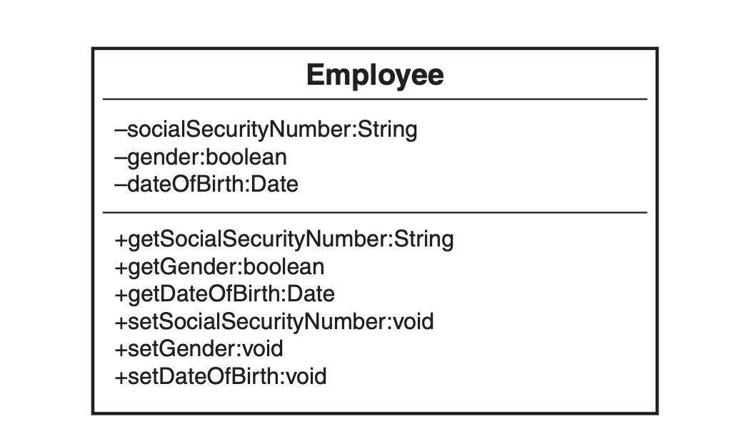
UML Class Diagrams

Slide 10
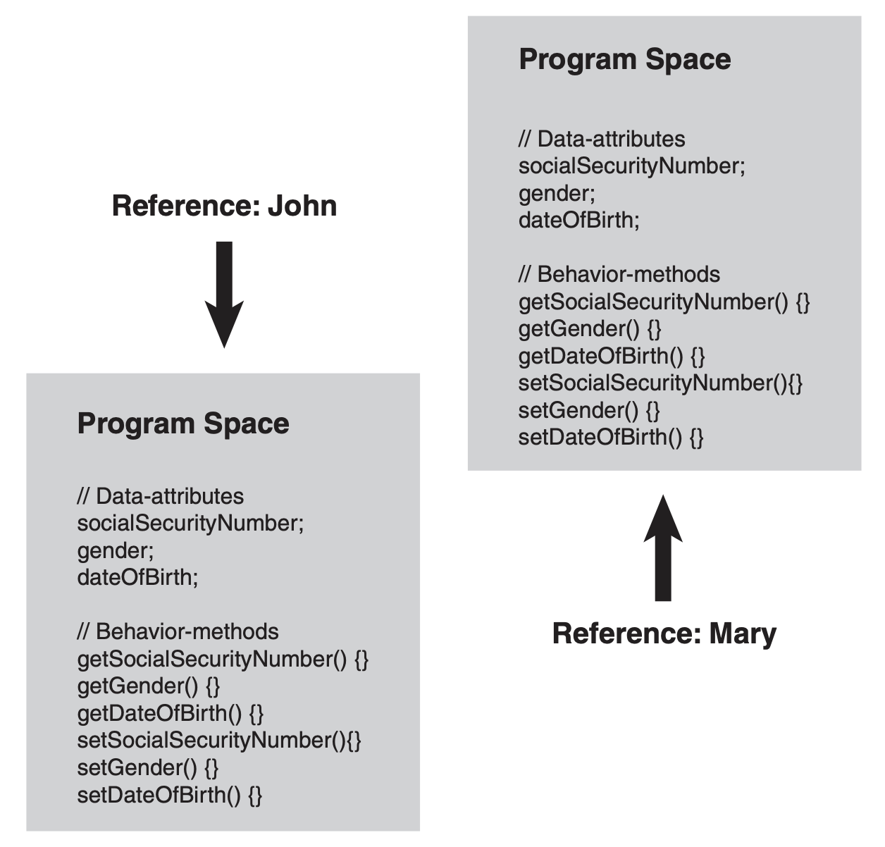
Program Space in OOP

Slide 11
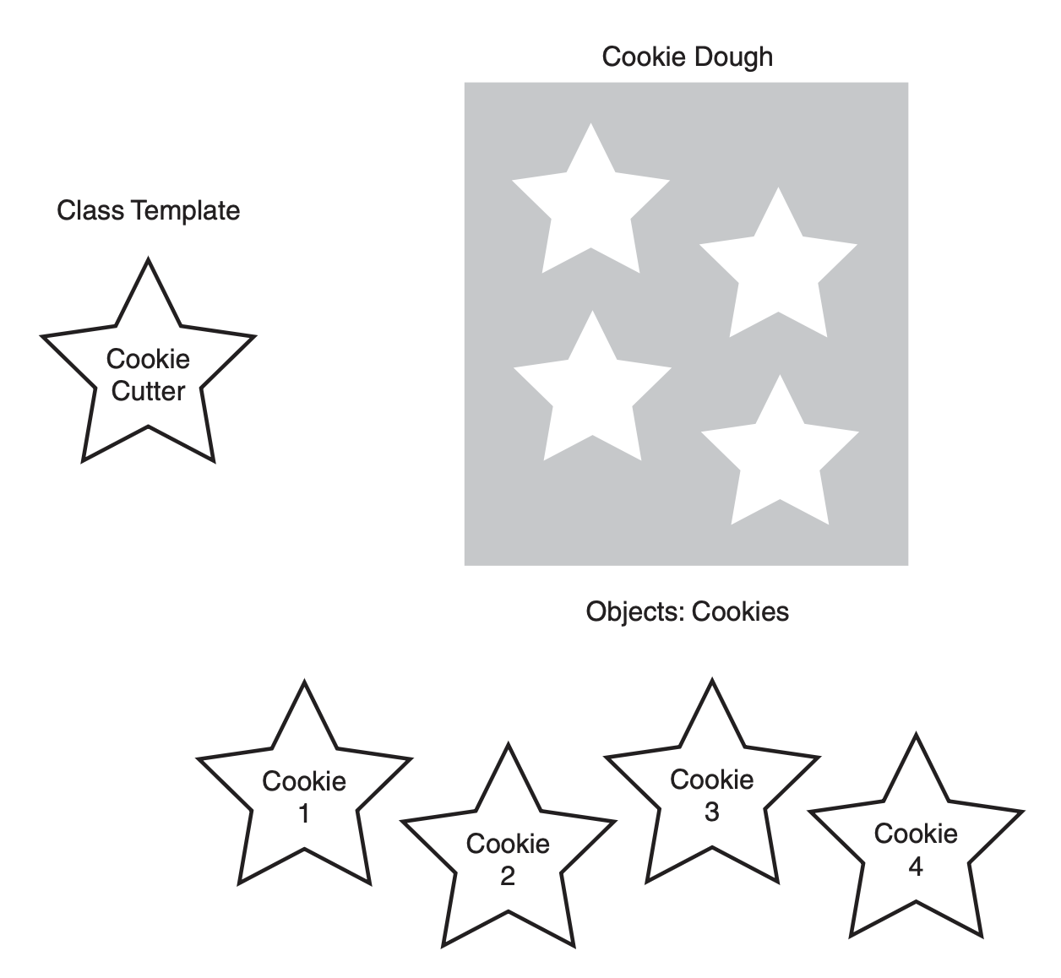
Classes Are Object Templates

Slide 12
Let’s design an UML class for Person
And design an UML class for Student

Slide 13
What is the relationship between a Person class and a Student class?

Slide 14
Inheritance
For reusing code – Inheritance allows subclasses to inherit functionality from a superclass, reducing code clone
For extending functionality – With inheritance, subclasses can add or override methods, extending the behavior of the parent class without modifying its code.
For establishing relationships – Inheritance creates a natural hierarchy between classes

Slide 15
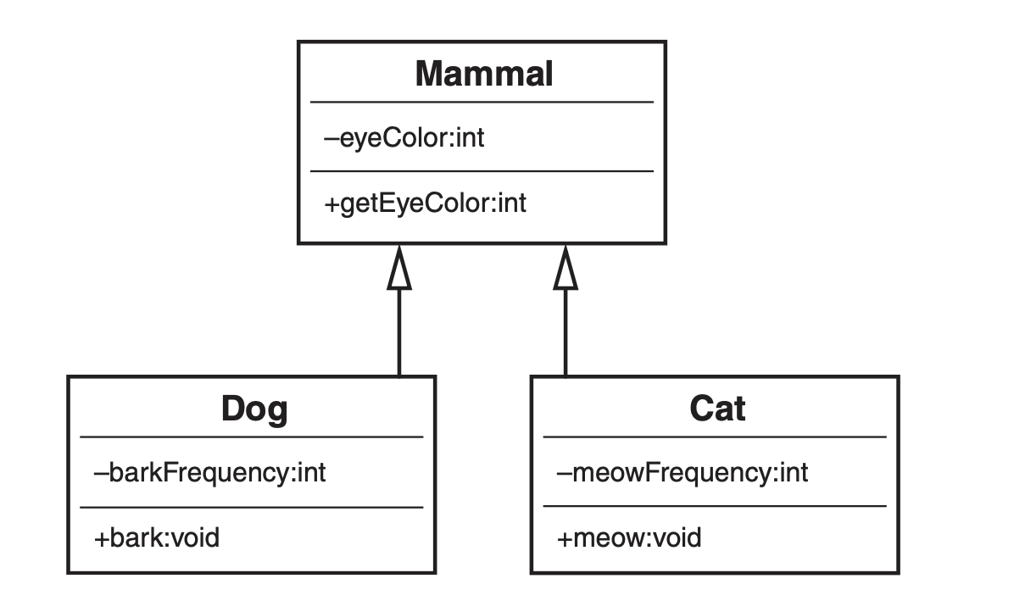
Mammal hierarchy

Slide 16
Design 3 Different UML Diagrams
with Inheritance

Slide 17
Superclasses and Subclasses
For code reuse : A subclass inherits attributes and methods from its superclass,
For specialization: A subclass can extend or modify the behavior of the superclass
For clear structure: The superclass defines general properties and methods, while the subclass refines or builds upon them

Slide 18
Abstraction
Abstraction allows developers to hide complex implementation details
Abstraction allows only expose the essential features
Abstraction helps separate the interface
By focusing on "what" an object does rather than "how" it does it

Slide 19
Example of Abstraction
package interface_example;
interface AnimalSound {
// Abstract method (no implementation)
void makeSound();
}
class Cat implements AnimalSound {
// Implementing the abstract method from the interface
public void makeSound() {
System.out.println("Meow! Meow!");
}
}

Slide 20
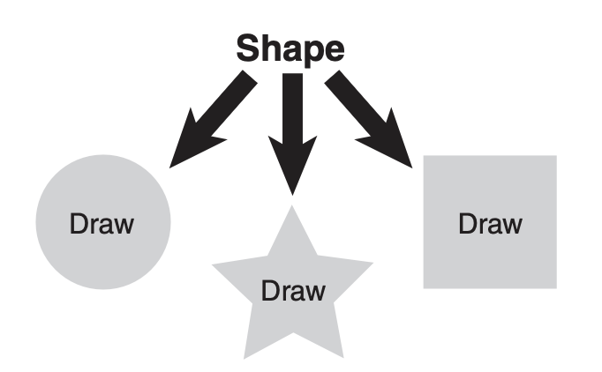
Is-a Relationships
How can an object be an 'is-a' object of other objects?

Slide 21
Polymorphism
Polymorphism allows a subclass to provide its specific implementation of a method that is already defined in its superclass
With polymorphism, a single method or function can operate on different types of objects
By using polymorphism, we can write cleaner and more concise code, as we don’t need to manually check the object type before performing operations

Slide 22
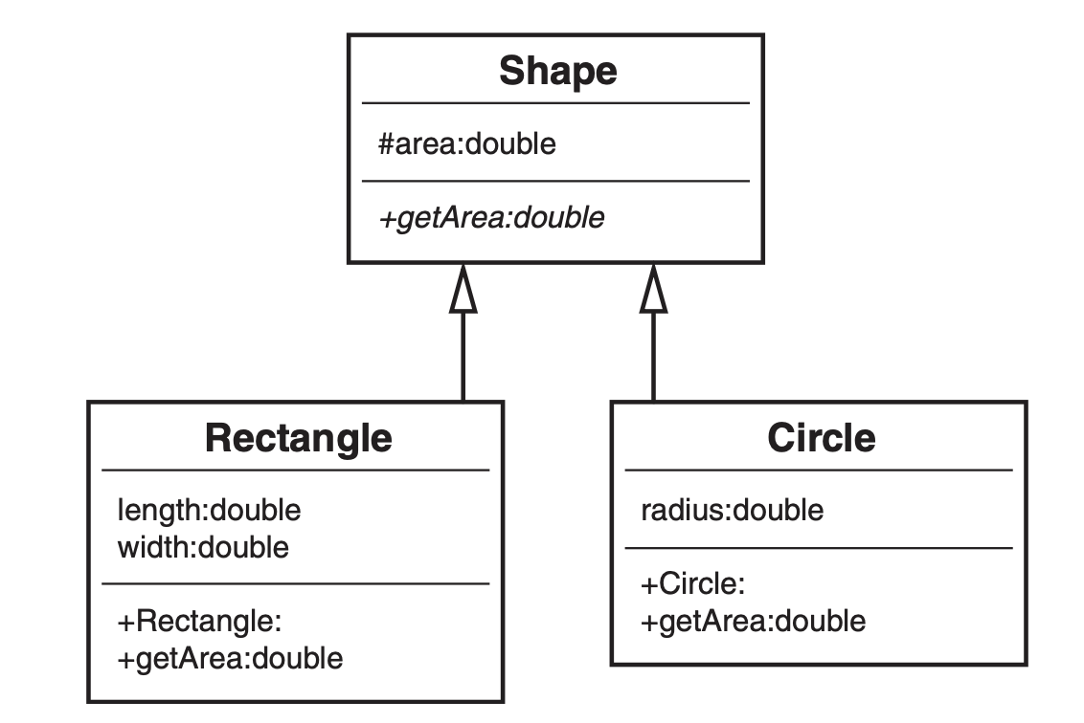
Polymorphism

Slide 23
Give me 3 examples on Polymorphism

Slide 24
See you next day …

